Slide 1
Spring Hill HOA Annual Meeting for 2024
Please sign in at the Welcome Table.
The meeting will start at 7 PM

Slide 2
Spring Hill HOA Board members
George Ortopan - President
Andy Hoch – Vice President *
Kerrie Murray – Treasurer
Rachel M Theken – Secretary *
Allison Hart – Committee Chair.
Ralph Tucker – Architecture Review Cmte.
Kevin Tremmel - Architecture Review Cmte. *
Open Position - Architecture Review Cmte. *
* (Potential Open Positions)
Notes:
Kevin Tremmel submitted his nomination for Vice President. Kevin has participated in multiple HOA projects outside of the ARC scope of responsibility.

Slide 3
agenda
Introduction of Board Members​
​
7 to 7:50 PM - Greetings and Introductions of guest speakers: (15 to 20 minutes each)​
Dehoff Development to discuss 2025 plans for Phase 5 and 6, address questions.​
City Services to discuss the new Street Trees and Sidewalk replacement project, address questions.​ ​ 7:50 PM - Annual HOA activity / projects summary, and budget report 2024 & projected 2025​ 8 PM - Discuss the HOA open board positions for 2025 and take nominations or interests.​
Vice President: Act with (or stead of) the President on Board issues and projects.​
Secretary: Keep minutes of meetings and activities, HOA communications, Newsletter.​
Architecture Review Committee (2) Homeowner requests for property modifications.​
New committee plans: Help with front entranceway & neighborhood social activities.​ ​ 8:15 to 8:45 PM - Homeowners and Board discussions on raised safety concerns for 2025:​
Kenway and Springbury curve hill areas; to implement street parking restrictions for safety and traffic concerns?​
Excessive Speeding: Work with the City and Sheriff offices on options to stop excessive speeding; installing speed reducing humps or other options?​ ​ 8:50 PM - Summary and Meeting Adjournment: ​
​

Slide 4
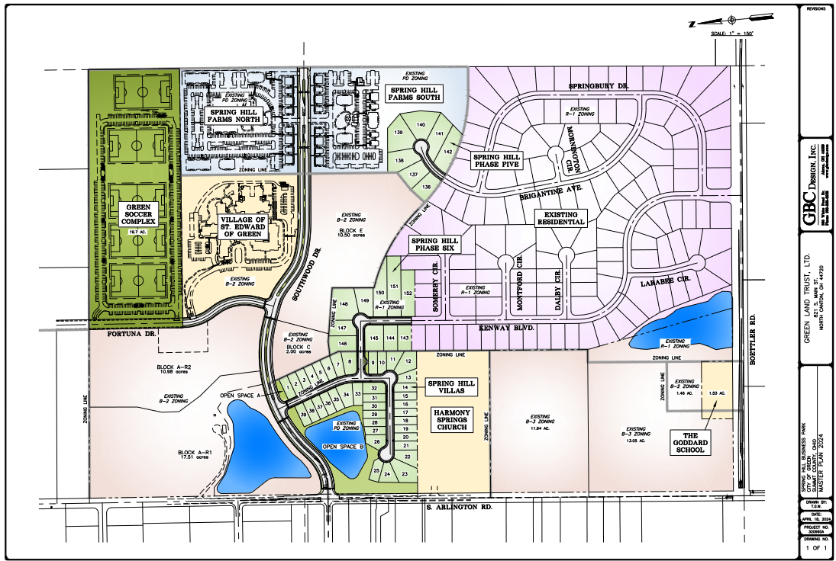
Spring Hill
Master Plan 2024
DeHoff Development
Plans for
2025

Slide 5
Public Services Dept. City of Green
Valerie Wax Carr, MPA Director of Public Service
Bryce Zimmerman
Update on the new Street Trees and Sidewalk replacement project.
Street Tree replacement process for dead or diseased trees.
Table discussions a 7:50

Slide 6
We appreciate DeHoff Realtors and Green City Services Dept. for attending our HOA meeting
We'll take a 5 minute Break before beginning the HOA Business Agena items...

Slide 7
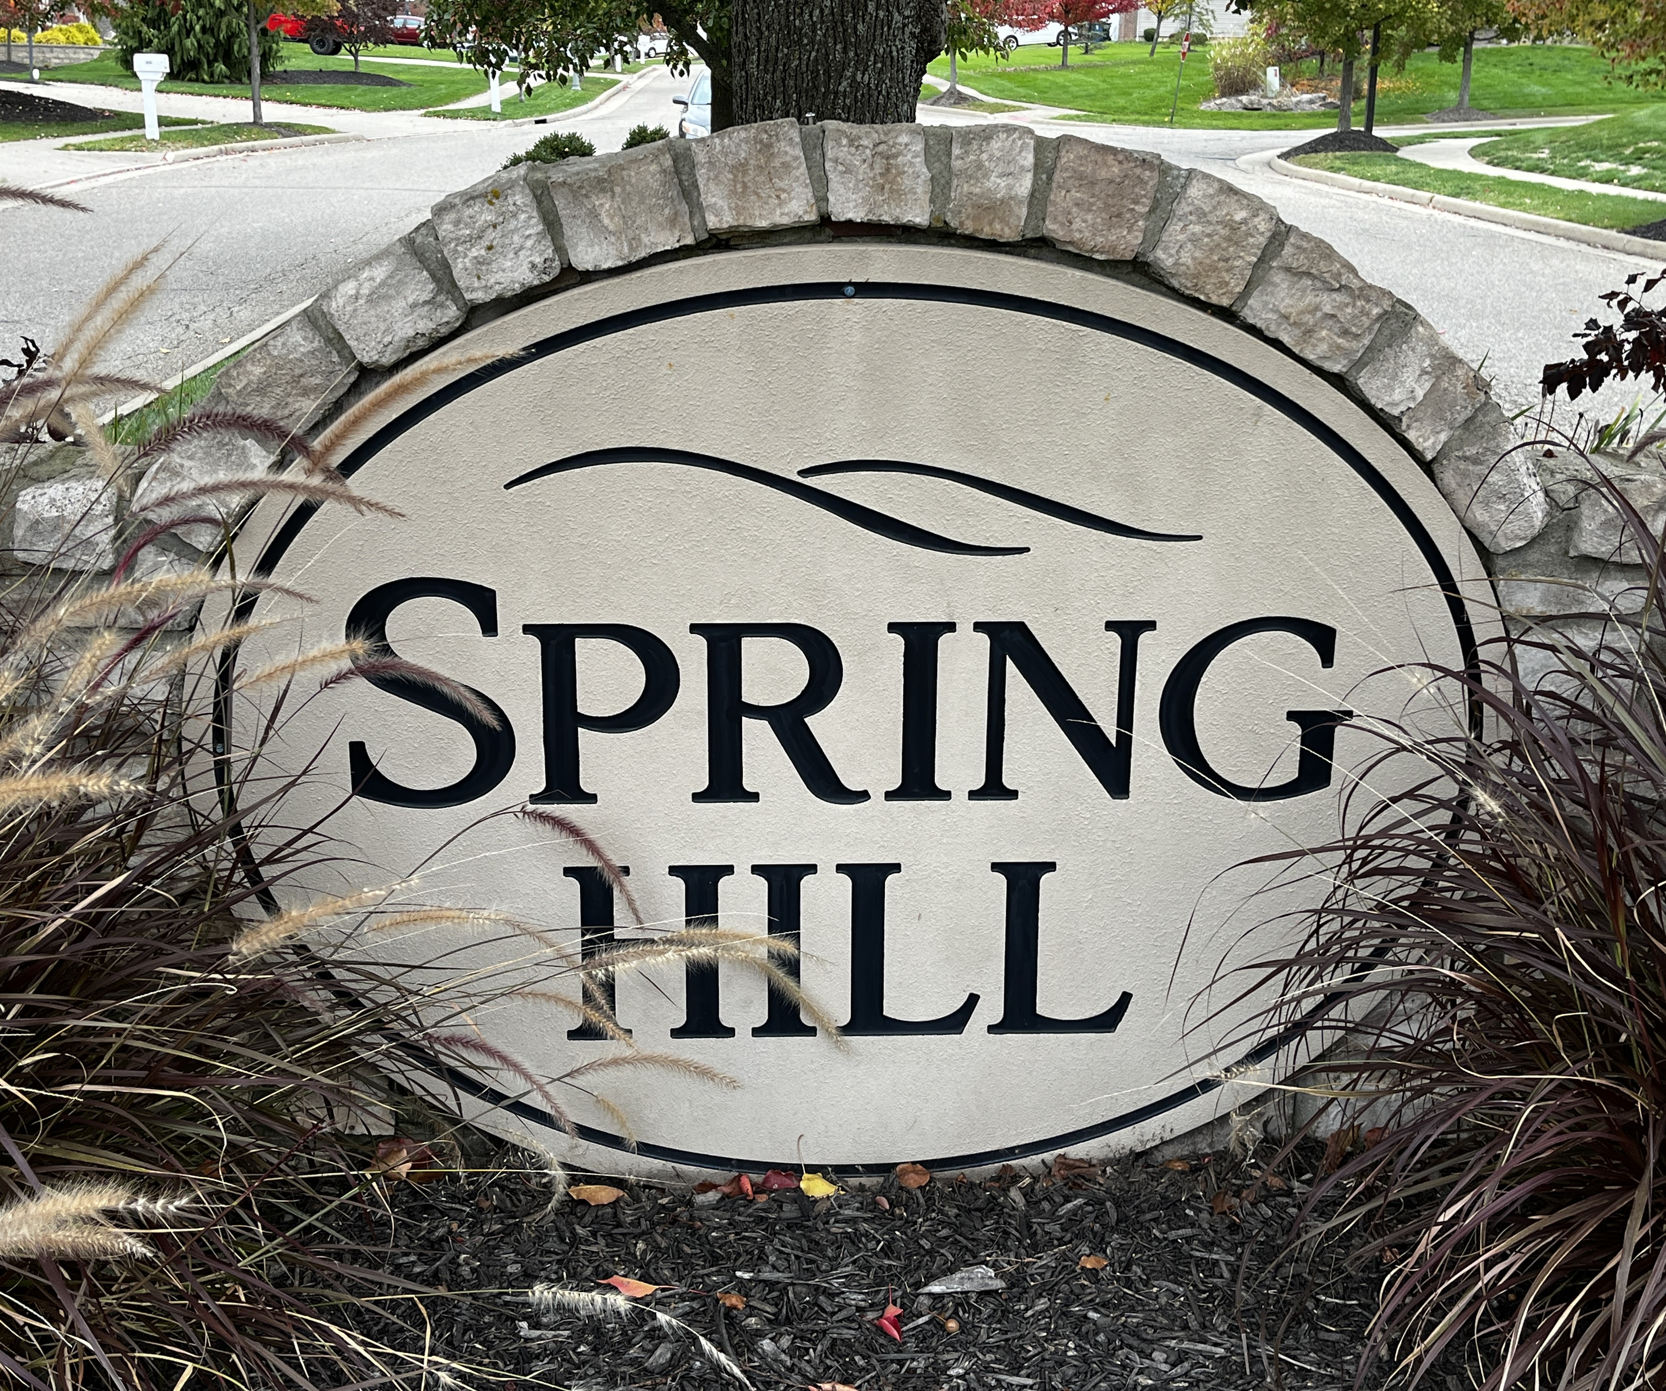
HOA Activities & Project Summary -2024
Implement Zelle for HOA fee collection – savings on PayPal fees
Boettler Rd. Fence repairs and leveling
Review and renew maintenance contractor agreements
Meetings with Bob DeHoff on Phase 6 Plans & Phase 5 covenants
Street Lights underground wiring repairs on Kenway
Entrance way landscape new plantings & improvements
Summer & Fall E-Newsletter publishing and distribution
Spring Hill street sign post maintenance and painting
Resolve homeowner compliance on Above Ground pool
Peruse and resolve late HOA fees and penalties
7:50 to 8:00 PM

Slide 8
HOA Activities & Project Summary -2024 (ARC Items)
Street Tree replacement process with City Services.
Two Street Tree replacements on Springbury and Kenway
Meet with City Services on Sidewalk repair / replacement project.
Investigate speed limiting options with City Engineer and Sheriff
Entrance way Wall crack repairs
Entrance way Tree Pruning and fall clean-up
Eight homeowners mowing compliance on Boettler
Street Tree pruning by homeowners - compliance & inspection
Three new Fence requests
One Garage Addition request
Ree pruning and fall crean-up
7:50 to 8:00 PM

Slide 9
2024 Budget
 | Budget | Actual
Beginning Reserve Balance | $ 19,154 | $ 19,154
Increases:
HOA Dues | $ 32,500 | $ 33,654
Decreases:
Landscaping- Sekulik | $ (9,735) | $ (7,402)
Landscaping- Top Turf | $ (1,845) | $ (1,537)
Landscaping - Other | $ (4,325) | $ (2,812)
Electrical Work | $ (5,715) | $ (7,263)
Pond | (7,200) | (9,000)
Legal | (1,000) | (865)
Utilities | (3,000) | (2,684)
Property Taxes | (6)
UPS Box | (250) | (240)
Mailings | (350) | (731)
Website | (300)
Insurance | (1,600)
Fees | (160) | (5)
Zelle | (975) | (33)
Fence Repair | (3,310) | (3,310)
 | $ (39,771) | $ (35,882)
Net Increase | $ (7,271) | $ (2,228)
Ending Reserve Balance | $ 11,882 | $ 16,925

Slide 10
2025 Budget
 | Budget | Actual
Beginning Reserve Balance | $ 15,175 | $ 17,175
Increases:
HOA Dues | $ 32,500 | $ -
Decreases:
Landscaping- Sekulik | $ (9,735) | $ -
Landscaping- Top Turf | $ (1,845) | $ -
Landscaping - Other | $ (4,325) | $ -
Electrical Work | $ (5,715) | $ -
Pond | (7,200) | -
Legal | (1,000) | -
Utilities | (3,000) | -
Property Taxes | (6)
UPS Box | (250) | -
Mailings | (350) | -
Website | (300)
Insurance | (1,760)
Fees | (20)
Zelle | (50) | -
Board Concession | (1,750) | -
 | $ (37,306) | $ -
Net Increase | $ (4,806) | $ -
Ending Reserve Balance | $ 10,369 | $ 17,175

Slide 11
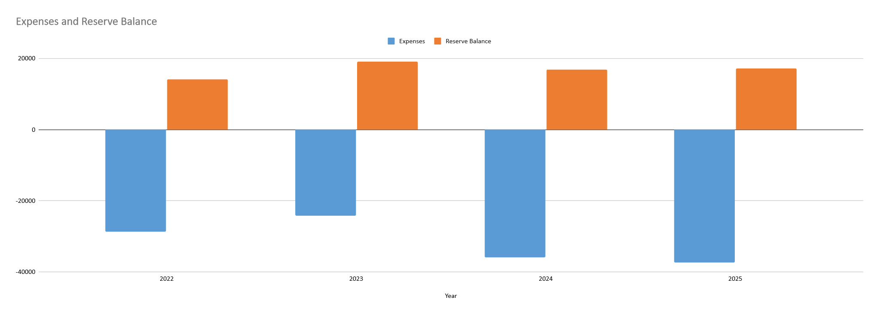
HOA Annual Expenses vs. Reserve Budget
2022 thru 2025
7:50 to 8:00 PM​

Slide 12
HOA open Board Positions for 2025 The floor is open for nominations or interests.
Vice President: Act with (or stead of) the President on Board issues and projects.
Secretary: Keep minutes of meetings and activities, HOA communications, Newsletter.
Architecture Review Committee: (2 positions) Homeowner requests for property modifications.
New Committee plans: (Allison Hart Chair) Help with front entranceway & neighborhood social activities. * Holiday Lighting & Decoration contest.
8:00 to 8:15 PM
Notes:
To acknowledge the personal time dedicated by each board members who actively participates in HOA activities and projects throughout the year, the board approved HOA fee concessions for the following year.
We hope this will encourage ongoing HOA board membership to avoid Receivership proceedings of Spring Hill neighborhood to be manage by expensive outside organizations. organizations.

Slide 13
Notes:
Allison to discuss contest,

Slide 14
Spring Hill Homeowners and HOA Board discussions on Raised Safety Concerns for 2025:
Parking on Kenway and Springbury curve hill areas:
Implement street parking restrictions for safety and traffic flow concerns?
Excessive Speeding over 25 MPH:
Work with the City and Sheriff offices on options to stop excessive speeding; installing speed reducing humps or other options?
Possible increase traffic on Kenway with completion of Phase 6?
8:45 Table open discussions and 8:50 adjourn meeting.

Slide 15
The HOA Board thanks you for your time, interest, and participation in our annual Spring Hill Community meeting.
We wish you a Happy Thanksgiving and Blessed Christmas holiday season.

